Slide 1

Putting People at the Center of the Practices

Slide 2
Reminders
1
Participants will be muted during this webinar. You can use the chat feature in Zoom to post questions and communicate with the hosts (chat “To Everyone” for all to see).
2
Toward the end of the webinar, our speakers will have an opportunity to respond to questions that have been entered into chat.
3
The webinar is being live captioned in English.
4
Attendees may receive 1.5 Continuing Education Credits. To confirm attendance, please login to the webinar via your Zoom account.
5
The live webinar includes polls and evaluation questions. Please be prepared to interact during these times.
This webinar is being recorded. The recorded webinar will be available at www.hsri.org/nd-pcp within two weeks, along with a PDF version of the slides, and questions and responses.
6

Slide 3
Agenda
10:30 - 10:40 | Welcome Jake Reuter and Pamela Sagness
10:40 - 11:10 | Presentation Jennifer Turner
11:10 - 11:15 | Break
11:15 - 11:20 | Welcome Back
11:20 - 11:55 | Panel of Individuals with Shared Experiences Alisha Owens, Lindsay Schuh, Shannon Strating and Shannon VandeVenter
11:55 - 12:00 | Closing + Next Steps

Slide 4


Welcome
Pamela Sagness
Executive Policy Director, Behavioral Health Division
Responsible for identifying service needs and activities in the state’s behavioral health system.
Works with partners to address behavioral health needs across the continuum from prevention to recovery.
Experience as a clinical provider in both the public and private sectors informs her development of effective programs and policies with a focus on systemic change.

Slide 5

Statewide + Systemwide Initiative
Person-Centered Practices (PCP) assist individuals in having control over the life they desire, and fully engaging in their communities.
North Dakota is developing a strong and consistent statewide vision and universal understanding of person-centeredness across all North Dakota Department of Human Services entities and community partners.

Slide 6
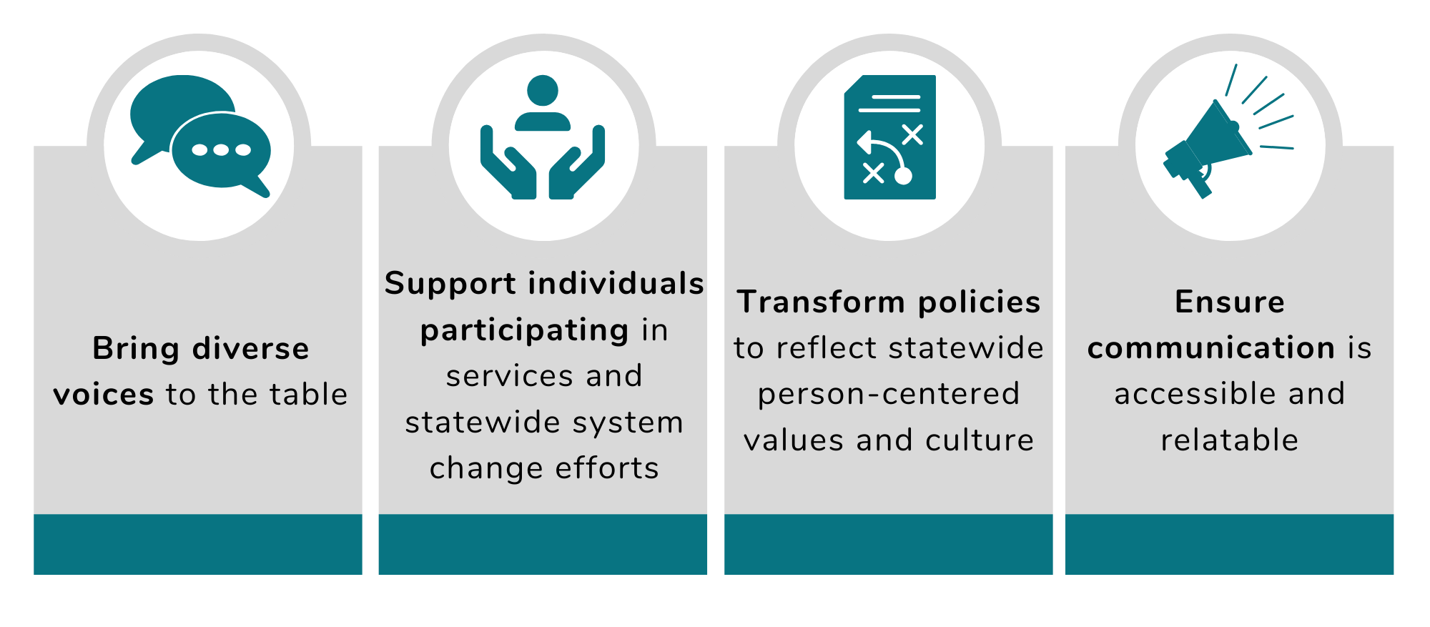
How to Implement

Slide 7
Support from Subject Matter Experts
Technical Assistance
The National Center on Advancing Person-Centered Practices and Systems (NCAPPS) helps states, tribes, and territories implement person-centered thinking, planning, and practice in line with US Department of Health and Human Services policy. North Dakota is one of 15 states to receive Technical Assistance for up to 100 hours of subject matter expertise for three years, to help advance person-centered thinking, planning, and practice. The third year begins in October 2020.
Collaboration with Local ND Stakeholders and Tribal Nations
Local organizations, advocacy groups, and representatives from Tribal Nations have contributed to development of North Dakota’s Person-Centered Practices initiative.
Project Management
Support for the statewide initiative, including coordination of efforts, is being provided by the Human Services Research Institute (HSRI).

Slide 8
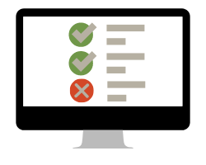
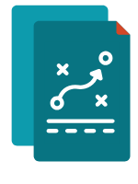
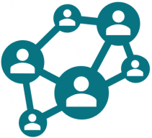


Materials
www.hsri.org/nd-pcp
A public website with updates on North Dakota’s PCP system change initiative.
Technical Assistance Plan
NCAPPS, HSRI, a cross-division workgroup and subject-matter experts are managing North Dakota’s plan and related activities to ensure system change.
Person-Centered Practices Summit
Three-part webinar series in Fall 2020 to engage individuals receiving services, their families, stakeholders, and providers in a true form of collaboration to reach a shared understanding of PCP, facilitate connections, embrace cultures and promote improvement for system change.
Asset Map
A working tool to:
document existing stakeholder engagement opportunities
encourage systematic and strategic thinking about next steps
save time and resources
reference when brainstorming potential groups to engage
expand and improve on current systems and processes
How to Engage Individuals Who Receive Services
North Dakota’s Guide of Best Practices outlines proven strategies on how to consistently involve individuals in workgroups and teams, so they are at the table when decisions are being made.

Slide 9
Person-Centered Practices Self-Assessment
All divisions in the Department of Human Services will engage in the Person-Centered Practices Self-Assessment process.
Aging Services
Developmental Disabilities
Children & Family Services
Behavioral Health
Vocational Rehabilitation
Administration Services
Medical Services (Medicaid Office)
Field Services (Life Skills & Transition Center)
The Self-Assessment is an online, internal tool for people who manage programs that offer support services to measure their progress toward building a more person-centered system.

Slide 10
Areas Covered in Self-Assessment
Person-Centered Culture
Eligibility &
Service Access
Leadership
Financing
How well people in charge know about and support person-centered practices.
How person-centered is the system’s culture and how can person-centered approaches help address risks.
How person-centered is the intake and assessment process for people seeking supports.
How are agreements with providers structured and how well are services helping people reach their goals.
Person-Centered Service Planning
Workforce Capacity & Capability
Collaboration & Partnership
Quality & Innovation
How is the process for creating person-centered plans and ensuring the services are working.
How well staff know about and have the skills to deliver person-centered planning and supports.
How are partnerships with service users, families, service providers, and advocacy organizations.
The agency’s mission and standards.

Slide 11
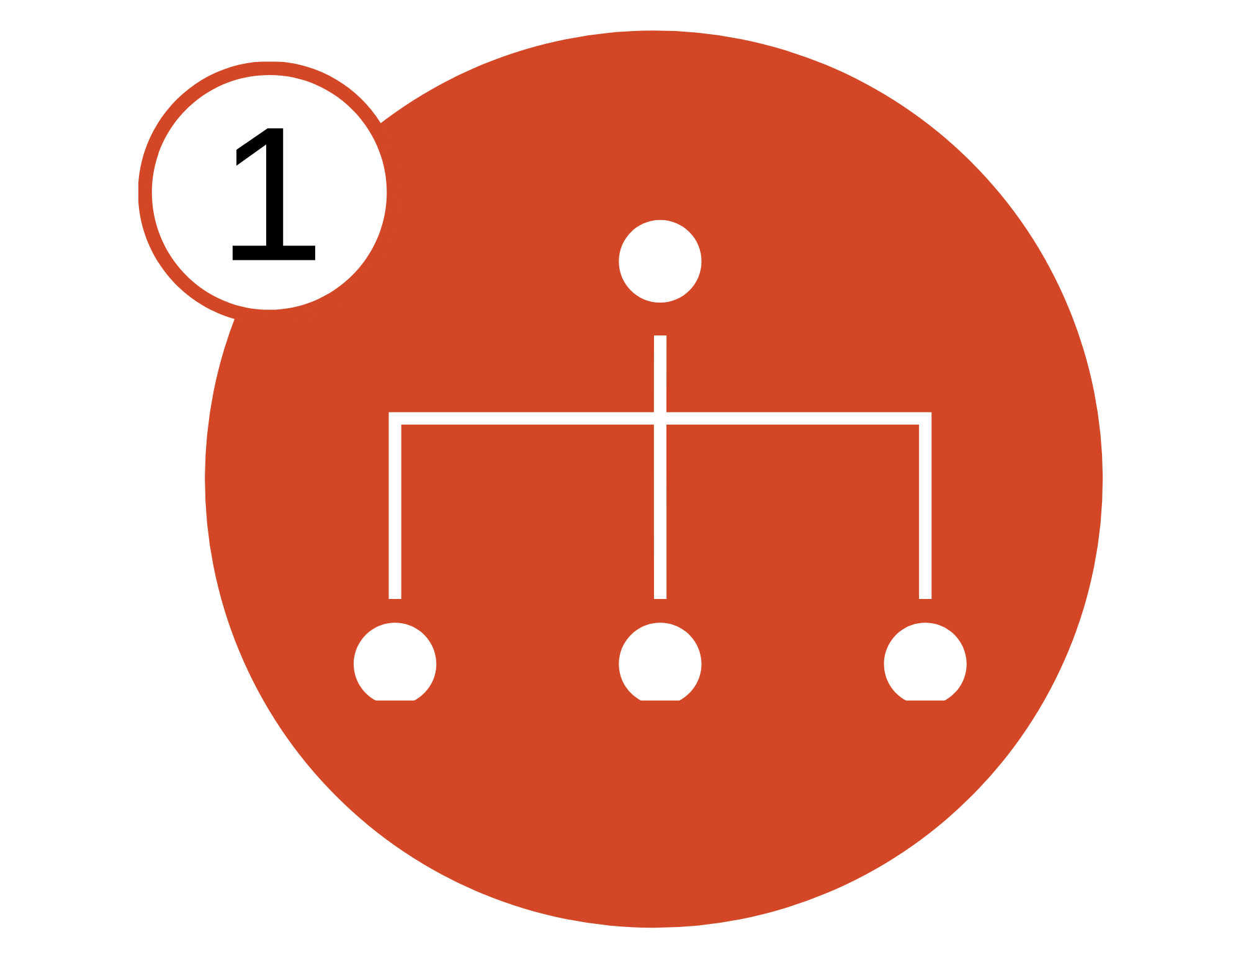


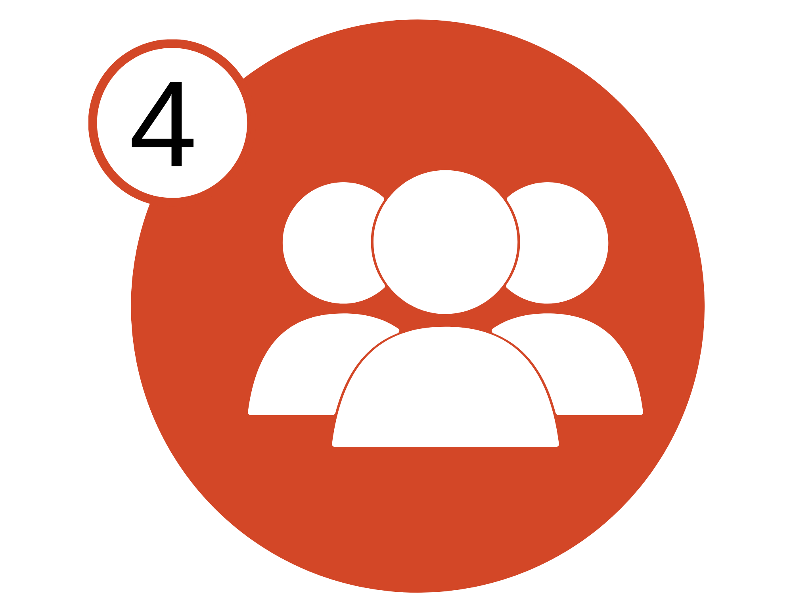
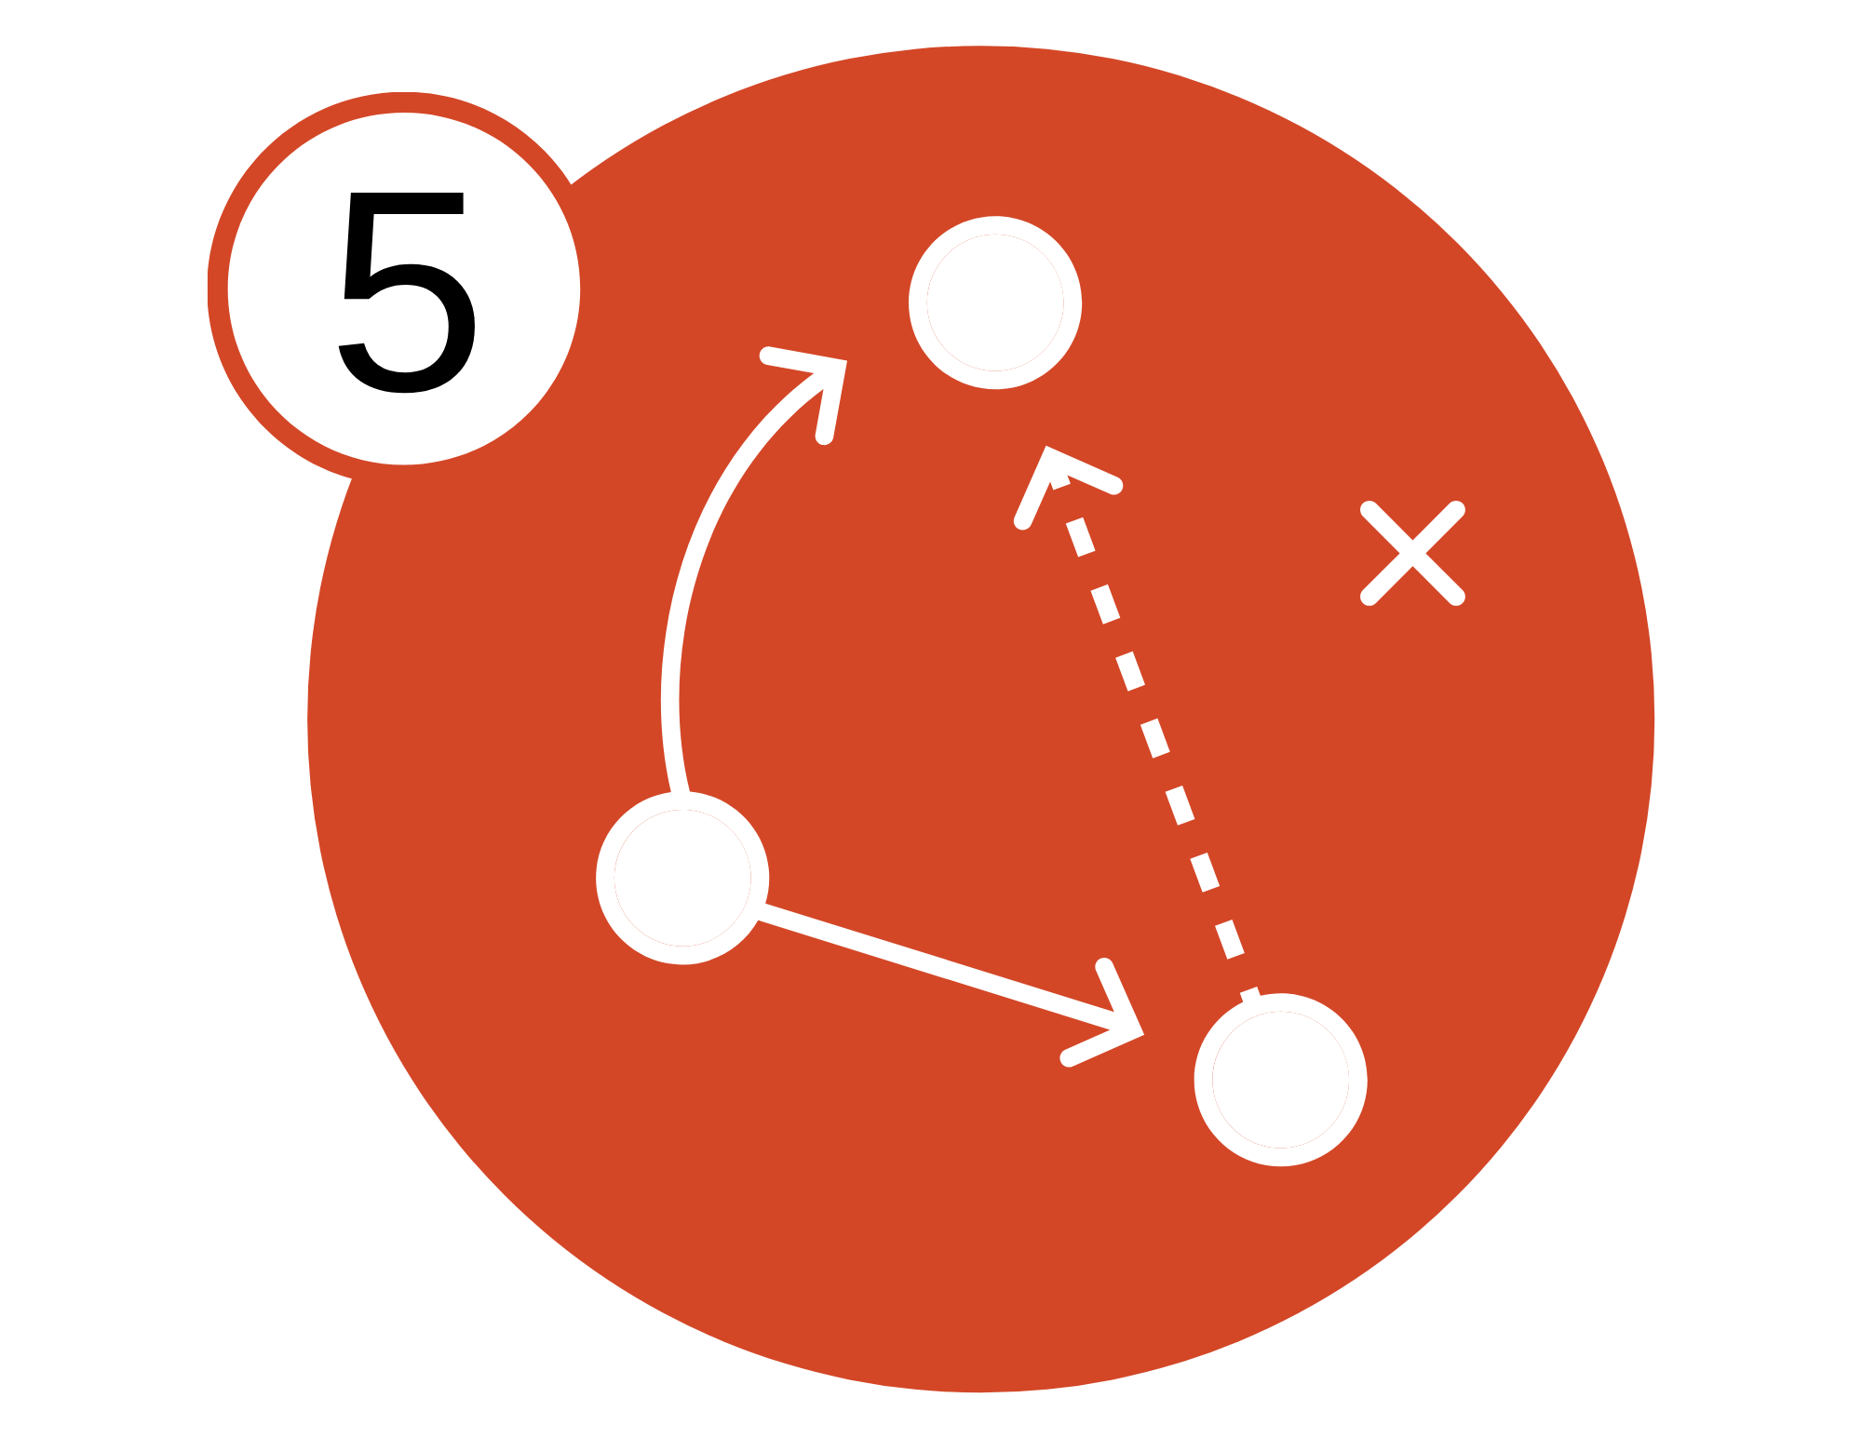



Self-Assessment Process
Assign Division Leads and Determine Participants
Participants Take Online Self-Assessment
Review Scores and Establish Consensus on Baseline Status
Engage Stakeholders and Service Users to Inform Action Plan
Use Information to Create Action Plan
Communicate Action Plan Throughout the Division
Evaluate Progress Every Six Months
Update System Goals

Slide 12
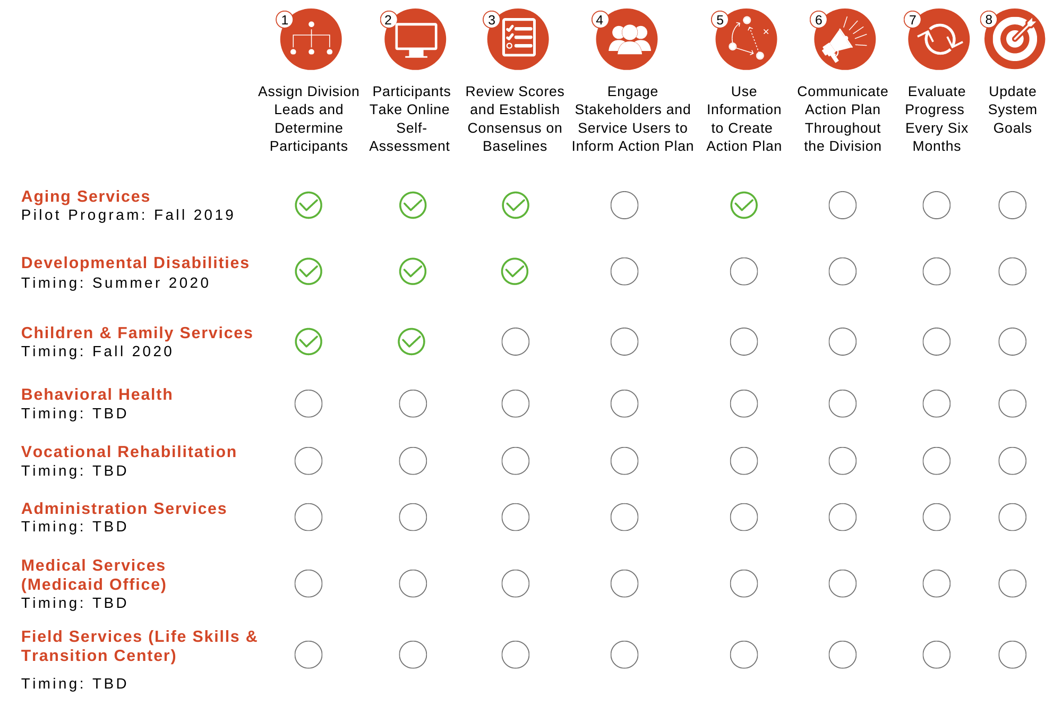
Status Update

Slide 13
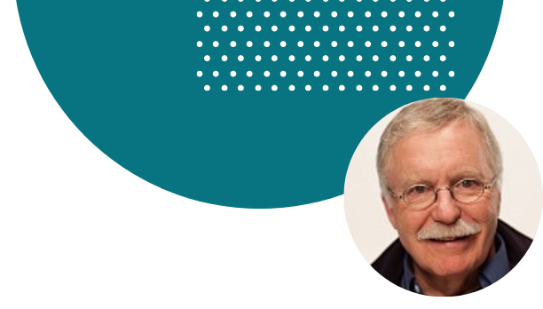
Recap of First Webinar
Building Foundations for Person-Centered Practices
Michael Smull
Person-Centered Planning is never done to you, is always done with you, and helps you move in a positive direction.
Person-Centered Planning is about asking the right questions, respectfully listening, and organizing the learning.
Good plans are living plans:
  You feel that you have met the person (and not just the disability)
  The plan respectfully reflects the person’s culture and identity
  You know what the person wants the plan to accomplish
  How to best support the person in moving toward their outcome(s) is clear

Slide 14
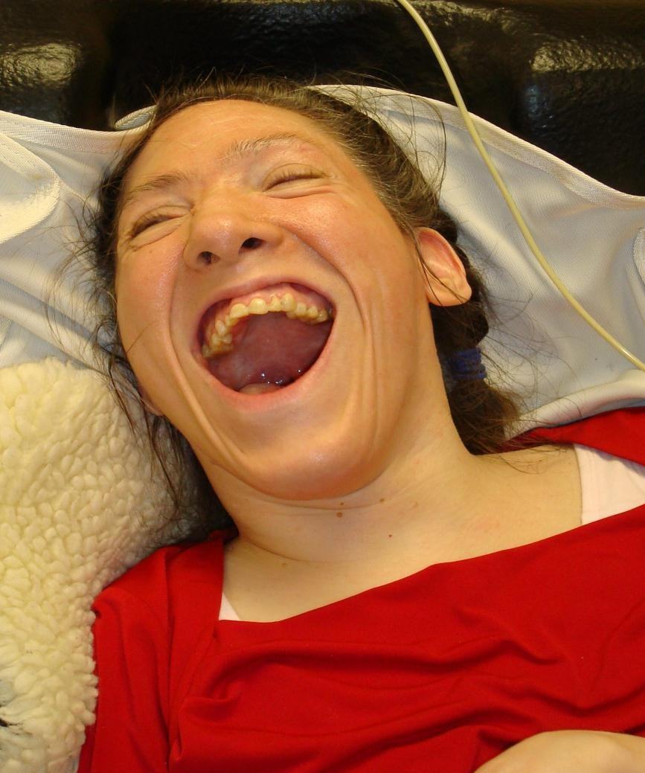
Tammy’s One Page Description
What is Important to Tammy (pages 7-8)
Being a part of things
Having eye contact with everyone
Looking stylish and having her hair and nails done
Being comfortable and not having her tubes underneath her
No roughness in personal care
Supports Tammy Needs to be Happy, Healthy and Safe (pages 10-14)
Always have her head elevated
To be suctioned frequently (5-6 times per shift). Gurgling noises means she needs to be suctioned
To have people be kind, sensitive, loving and have a gentle touch
Be gentle with brushing her hair (she doesn’t like it, but wants it to always look nice)
Always make sure her clothes match and make sure it’s not sweat clothes
Tammy needs to be repositioned every two hours
Always follow through with a promise or give an explanation of what is going on and when you can keep the promise if something comes up
Be sure to have Tammy use her body to keep flexible
What People Like and Admire about Tammy (page 6)
Is always smiling
Totally accepts people
WONDERFUL personality
Stylish
Accepting and forgiving
Resilient
Great sense of humor
Friendly and social
Tammy’s Picture Of A Life (Pages 19-21)
Live in a big wheelchair accessible home with extra wide doors, close to her family
Have a fun and social housemate
Have a beautician she can go to regularly
Have a social medical day program close to home
Have specialized medical services and medical equipment (including backup generator)

Slide 15
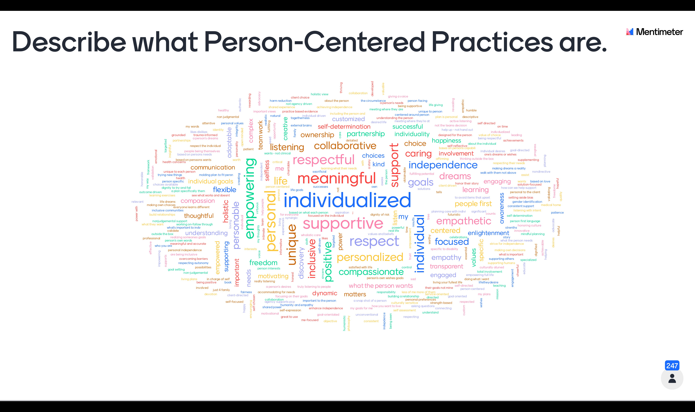
Describe what Person-Centered Practices are.

Slide 16
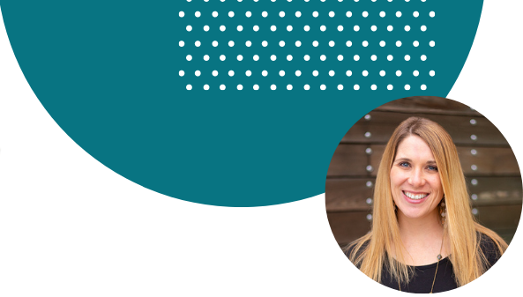

Presentation
Jennifer Turner, LCSW
Strategizer of Solutions, Charting the LifeCourse Nexus
turnerje@umkc.edu | 816-235-5450 | www.lifecoursetools.com
Passionate about the development and implementation of best practice that will drive systems change and impact families.
Lead for Organizational and System Change Initiatives at the University of Missouri – Kansas City, Institute for Human Development
Her commitment to advocacy and social justice originates in her first – and most important – role of “big sister” to two siblings – a sister in her 30’s with a disability and a sister who is 15 and adopted.
Licensed as a Clinical Social Worker
Formerly a Support Coordinator and Director of a Provider Agency
Co-Director for the National Community of Practice for Supporting Families
Subject Matter Expert for the National Center on Advancing Person-Centered Practices and Systems

Slide 17


Today’s Objectives
1
Introduce the Charting the LifeCourse framework that is being used to enhance policy and practices around the country.
2
Toward the end Share concrete examples of the Person-Centered Practices that support choice, control, and decision-making.

Slide 18
Overview of the Charting the LifeCourse Framework

Slide 19

Who We Are
University of Kansas City Institute for Human Development, UCEDD conducts and collaborates on a wide variety of applied research projects to develop, implement, and evaluate new ideas and promising practices that support healthy, inclusive communities.

Slide 20




Charting the LifeCourse
Exchange
Build
Collaborate
Access to Resources and Tools
Training
Technical Assistance
Innovate and Enhance
Develop
Research
Network and Connect
Share Learning
Share Stories

Slide 21

The National Community of Practice for Supporting Families
Enhances and drives policy, practice, and system transformation to support the person within the context of their family and their community.
Collaboration Between:
National Association of State Directors of Developmental Disability Services

Slide 22
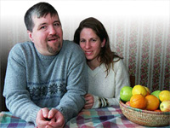
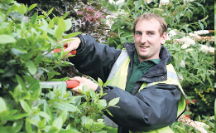
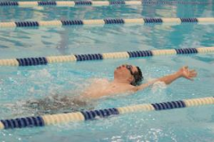
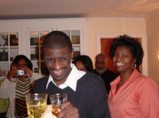
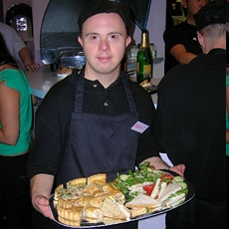
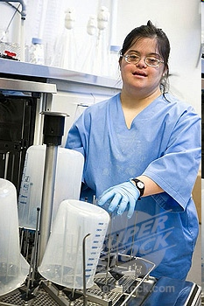
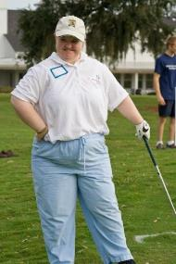
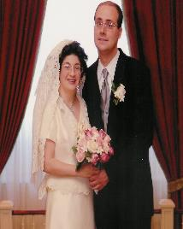
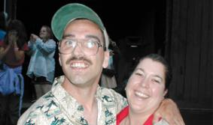
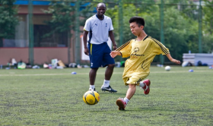
Core Belief:
All people and their families have the right to live, love, learn, work, play
and pursue their life aspirations in their community.
Notes:
Collage of pictures of people of all ages with and without disabilities participating in every day activities, such as playing golf, swimming and playing soccer. Working at a restaurant, hospital and farm. Hanging out with friends and getting married.

Slide 23
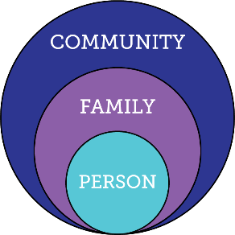
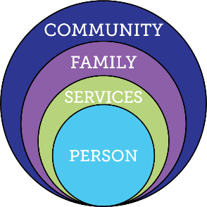
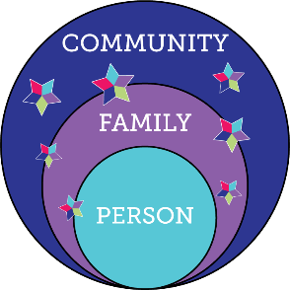
Transforming Services and Supports
Everyone exists within the context of family and community
Person in relation to Traditional Disability Services
Integrated Services and Supports within context of person, family and community

Slide 24
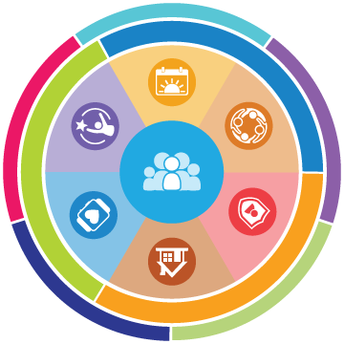
What is Charting the LifeCourse
Created to help individuals and families of all abilities and all ages:
develop a vision for a good life
think about what they need to know and do
identify how to find or develop supports
discover what it takes to live the lives they want to live

Slide 25

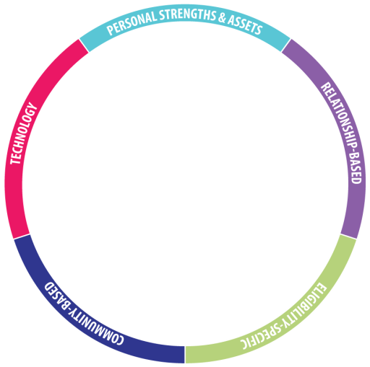
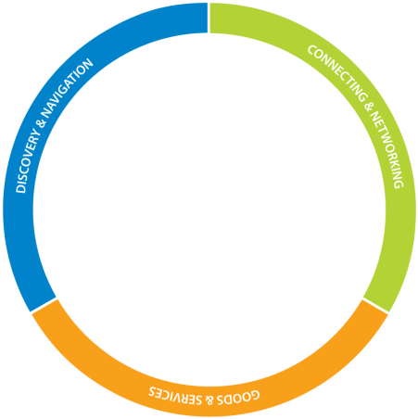
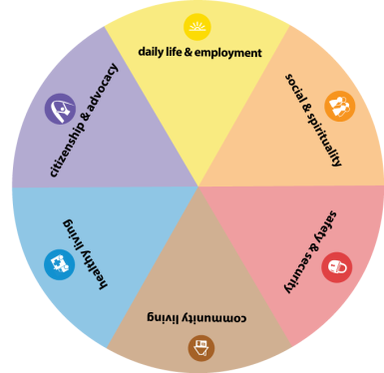








Slide 26
What is Charting the LifeCourse
Guiding Framework
Guides thinking and problem-solve
Practices
Specific Area
(action, policy, procedure)
to enhance or change
Tools
Educational Resources
Planning & Problem-solving Worksheets

Slide 27






Supporting a Person to Identify a Vision for a Good Life

Slide 28
The future is not something we enter. The future is something that we create. And creating that future requires us to make choices and decisions that begin with a dream.
-Leonard L. Sweet

Slide 29
Vision of a “Good Life”
What is YOUR Vision for a “Good Life”?
What is NOT
a Good Life?

Slide 30
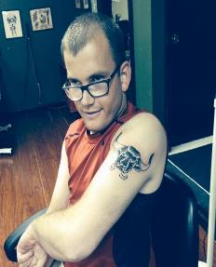
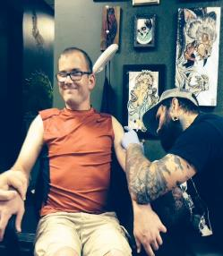
Trajectory Towards Good Life
VISION
Family Friends TATTOOS
Vacations Girlfriend
Concerts WWE NASCAR
Money Job/own business
Fire Station Church
Tiger Football Royals
Good Food Pepsi Beer
Active Healthy & Fit
WHAT I DON’T WANT
Poverty/No Money
Poor Health Diabetes
Heart Disease Guardian
Isolated/Segregated
Institution/group home
Treated Differently
Trajectory Towards Life Outcomes
Trajectory towards things unwanted

Slide 31






Life Experiences = Life Domains
Chores and allowance
Making Mistakes
Dating & Heartaches
Birthday parties with friends
Summer jobs, babysitting
Learning to say “no”
Playing sports or an instrument
Scouts, 4H, faith groups
CtLC Life Experiences Booklet and Quick Guides

Slide 32
Life Experiences = Life Outcomes = Good Life
Vision
More Possibilities
Expectations
Experiences
Opportunities

Slide 33
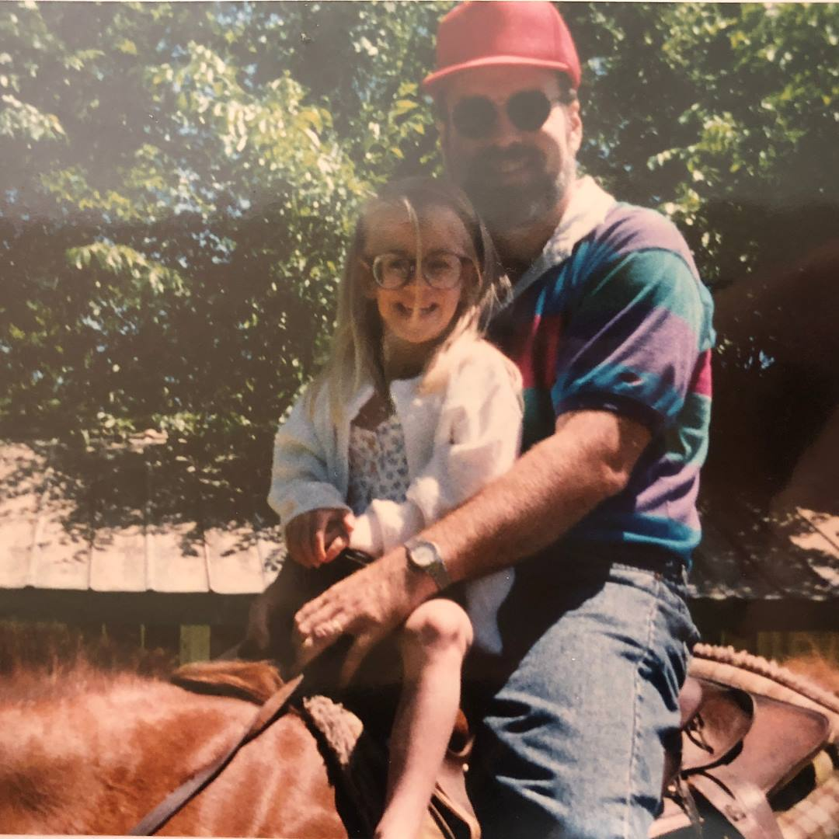
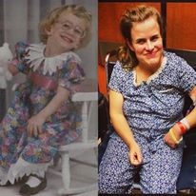
How the Story Began: Sarah
How Others Described Sarah:
Cerebral Palsy: “mobility issues”
Moderate Intellectual Disability: “requires significant support”
Chronic Hydrocephalus with multiple shunts: “medically fragile”
Low vision/hearing: “can’t navigate independently”
Sarah’s Family’s View:

Slide 34




Shaping the Rest of the Story: Sarah
Dating
Mentoring program
BASE Program for High School
Volunteering @ CARE
What We Want
Live independently
Get married and have kids
Work with animals or kids
Close relationships with friends and family
Church programs with others
KS State School for the Blind
Self-identifying symptoms
Inexperienced medical team who did not listen
What We DON’T Want
Reliant on others for medical care
Taken advantage of
Bored, low self-esteem
Others make all decisions choices for her
PT/OT/Speech Therapy
“Part of the family” responsibilities
Moving to a new city and starting over
“Special” treatment at school

Slide 35
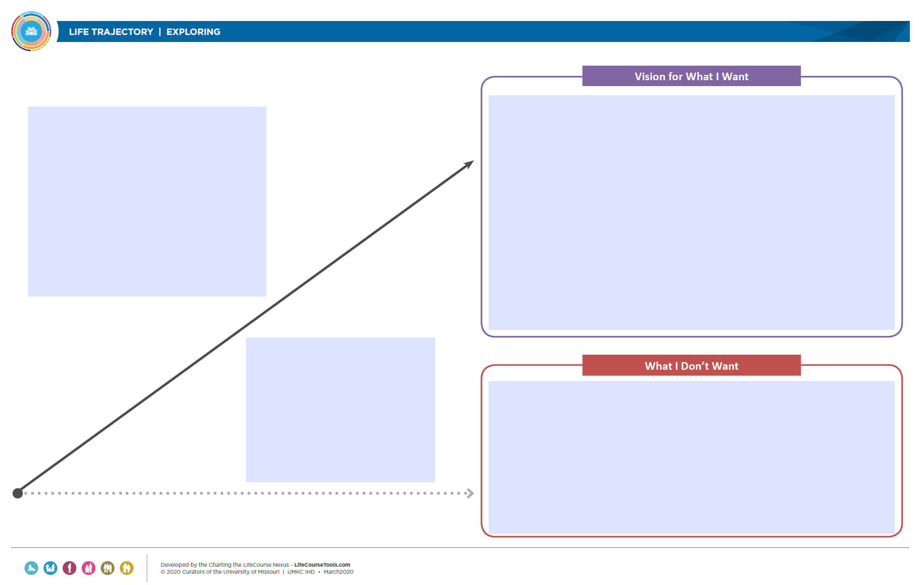
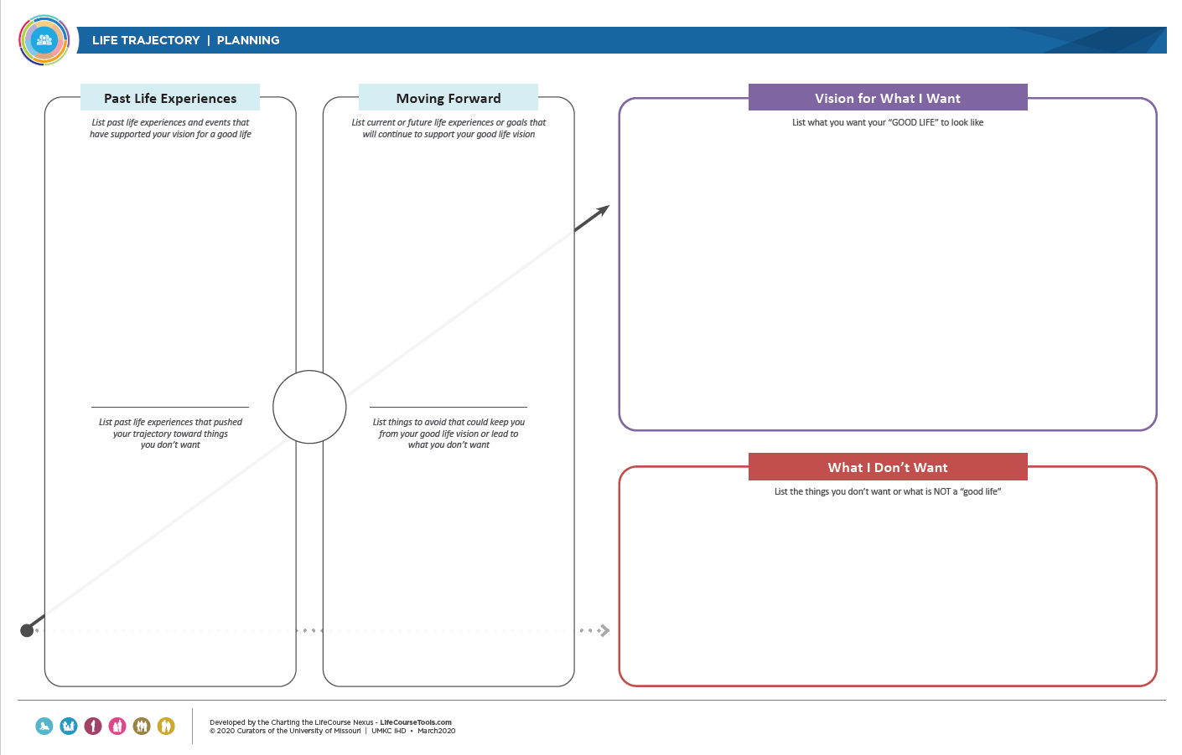
Tools for Exploring and Planning

Slide 36
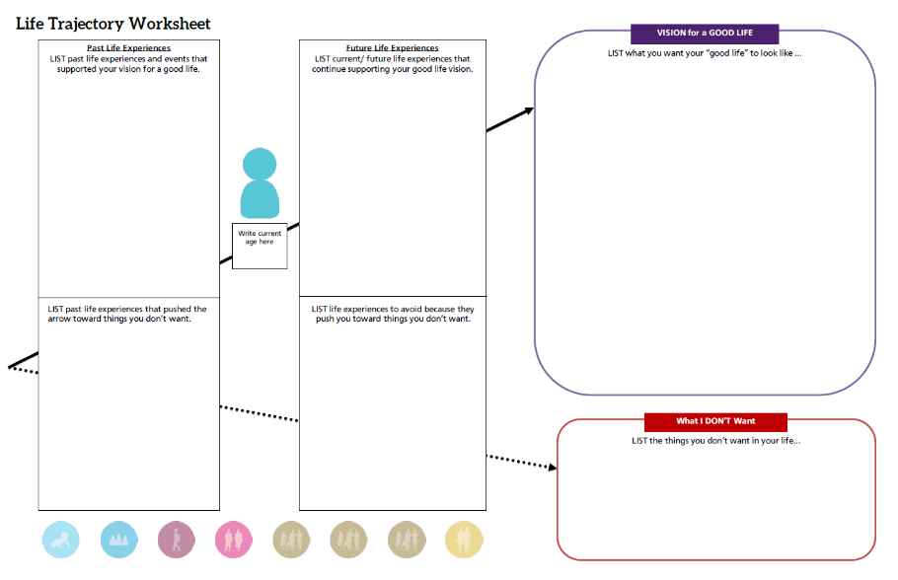
Chores; boy scouts;
School inclusion/circle of friends;
Birthday parties;
Riding bike;
Family vacations;
Church youth group; Debit card;
Football manager; Volunteering
High School diploma
Family and friends
Girlfriend
Vacations
Concerts; WWE; NASCAR
Tattoos
Money; job or my own business
Volunteer at fire station
Being Tiger football manager
Church
Healthy & fit
Good food; Pepsi
Basketball
Royals baseball
Staying active
Volunteer at fire station; \Workout regularly;
Keep in touch w/ friends; Increase alone time;
Go out with friends; Spend daytime hours out of the house;
Explore micro enterprise;
25
Special education low expectations;
Para glued to Ben’s side; Pressure to segregate; Medication side effects;
Scoliosis;
Seizures;
Physical barriers;
Sitting at home watching TV all day;
Rely on paid supports;
Gain weight;
Eat unhealthy foods or drink too much Pepsi (caffeine);
Poor health, heart disease, diabetes; Poverty/no money;
Guardianship; institution/group home; Segregation/isolation; being lonely
Being treated differently;

Slide 38
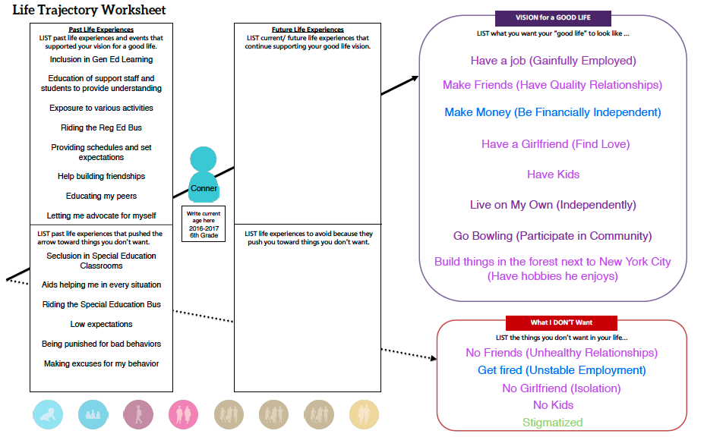
Trajectory for Planning Meeting

Slide 39

Determining Who Will Help to Reach the Vision and How

Slide 40
CtLC Integrated Support Star

Slide 41
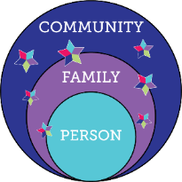
Integrated Services and Supports

Slide 42
Integrated Services and Supports

Slide 43
Integrated Services and Supports

Slide 44
Integrated Services and Supports

Slide 45
Integrated Services and Supports

Slide 46
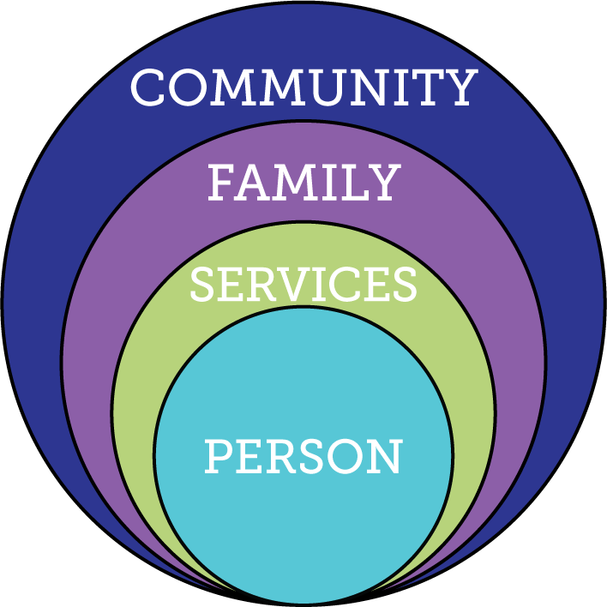

Focusing ONLY on Eligibility Supports
Friends, family, enough money,
job I like, home, faith, vacations, health, choice, freedom
Eligibility Supports
Poverty, loneliness, segregation, restrictions, lack of choice, boredom, institutions

Slide 47
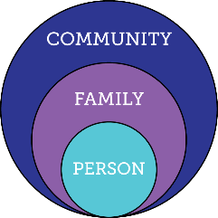

Relying ONLY on Family and Friends
Friends, family, enough money,
job I like, home, faith, vacations, health, choice, freedom
Relationships
Poverty, loneliness, segregation, restrictions, lack of choice, boredom, institutions

Slide 48
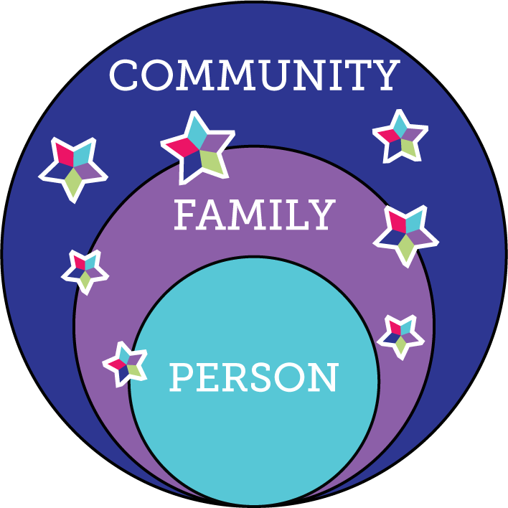
Integrated Services and Supports
Friends, family, enough money,
job I like, home, faith, vacations, health, choice, freedom
Poverty, loneliness, segregation, restrictions, lack of choice, boredom, institutions

Slide 49
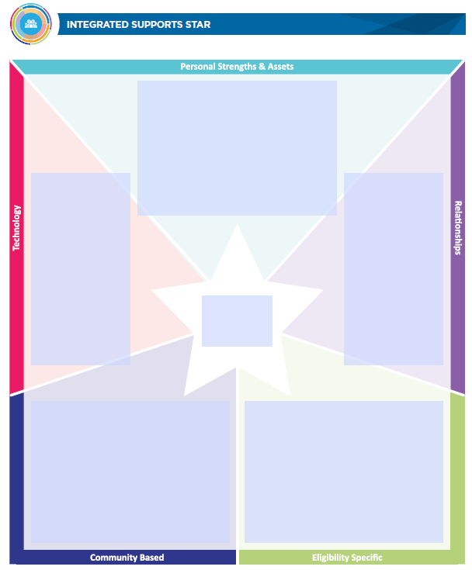
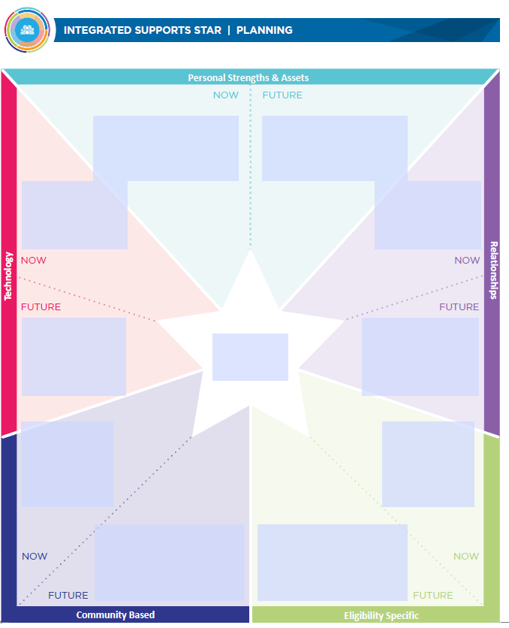
CtLC Integrated Support Star
Tools + Resources

Slide 50
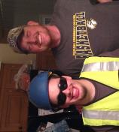
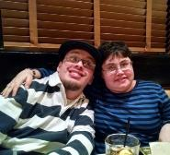

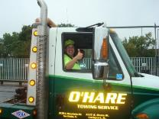
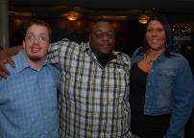
Mapping Relationships
Happy, Funny and loving
Likes to help people
Likes to try new things
Police cars, tow trucks, fire engines and racecars
Golf Cart
I-pad
Smart Phone
See his girlfriend more
Connect with his family
Spend more time with friends
Eric’s
Social and Spiritual
Scouts
Red Robin
Race Tracks
Companion Supports
day-to-day

Slide 51
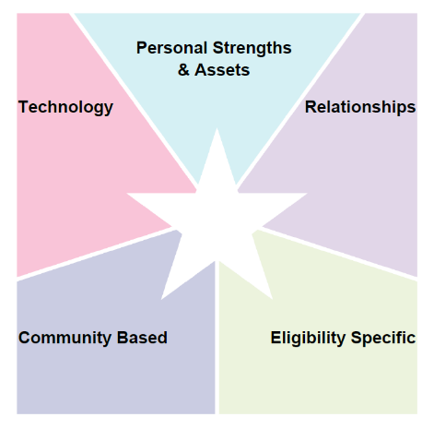
Problem Solving Transportation
Ability to follow a bus route
Ability to input information in the Metro Trip Planner
GPS
Find a Friend App
Google Maps
Metro Trip Planner
Neighbors
Co-Workers
Friends from Church
Family
Friends from Softball league
Ridefinders
Carpool Connections
Share the Ride STL
Uber

Slide 52
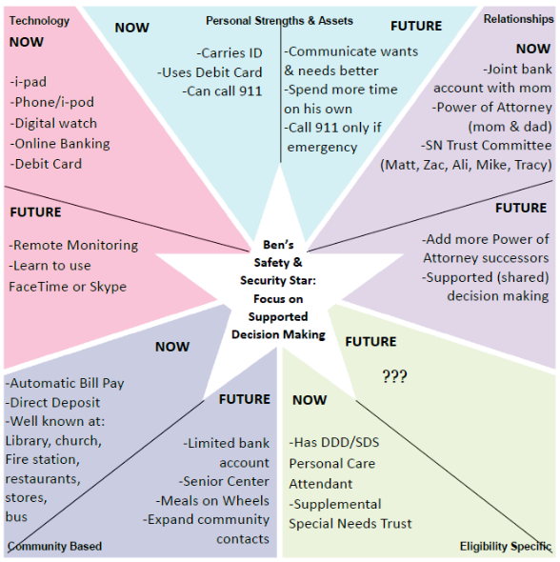
Problem
Solving for
Decision Making
Supports

Slide 53
Integrated Supports for Decision Making
Supports a person needs to understand their choices:
  Information
  Advice
Supports a person needs to communicate their preferences:
  Communication
Supports a person needs to follow through on their decisions:
  Reminders and logistics

Slide 54
Break:
Five Minutes

Slide 55




Panelists Sharing Lived Experiences
Alisha Owens
Community Options Client
Lindsay Schuh
Community Options
Shannon Strating
Aging Services HCBS Program Administrator
Shannon VandeVenter
Parent

Slide 56
DECISION MAKING CONTINUUM
GENERAL POWER
OF ATTORNEY
Person gives authority to another to act on their behalf in specific or all matters
CONSERVATOR
Court appoints someone to have the care and custody of the estate
PERSON AS LEGAL DECISION MAKER
Makes their own decisions with no extra help from anyone else
DURABLE POWER OF ATTORNEY FOR HEALTH CARE
Authorizes another to make health care decisions when the person cannot
SUPPORTED DECISION MAKING
Person makes their own decisions with support from others they know and trust
GUARDIANSHIP
Court appoints guardian to have care and custody of the person

Slide 57
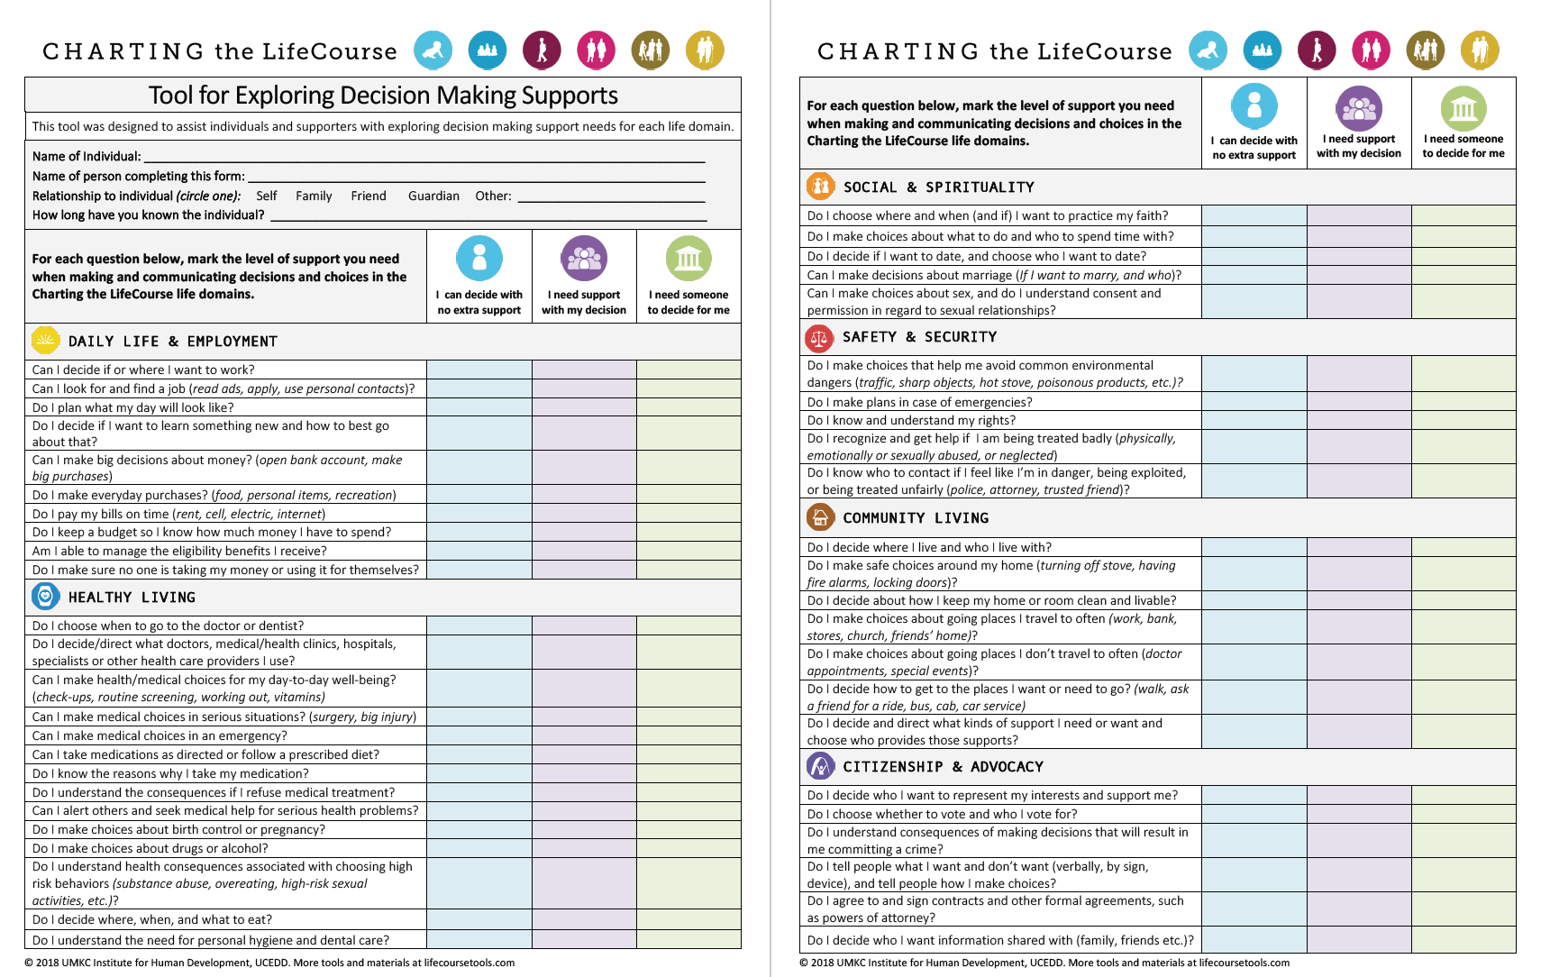
Exploring Supported Decision-Making Tool

Slide 58
Panelists
What are strategies for ensuring the person is informed of all their options – including the various supports and services – and is supported (as they need) to have choice and control?

Slide 59




Elevating the Voice of All Team Members
Supporting Person’s
Self-Determination
& Self-Advocacy
Supporting Families Across the Lifespan
Supporting
Person-Centered Practices

Slide 60








Tools for All Team Members
Planning for Life Outcomes and/or Service Planning
Self-Advocate
Tools & Resources
Family Perspective Tools
Formal Planning
Tools & Forms

Slide 61

Family Perspective Tools
www.lifecoursetools.com/lifecourse-library/foundational-tools/family-perspective/

Slide 62
Panelists
What are strategies for ensuring the person has a voice in their planning process – and that it is distinct from the rest of the team?

Slide 63

Dignity of Risk and Mistakes
Friends, family,
enough money,
job I like, home, faith, vacations, health, choice, freedom
Poverty, loneliness, segregation, restrictions, lack of choice, boredom

Slide 64
Panelists
When a “risk” is identified, what are strategies to support the person and the team in planning for that risk?

Slide 65
Questions + Answers

Slide 66
Closing + Next Steps
1
Register for our next webinar (and invite colleagues and friends!) at: https://zoom.us/webinar/register/WN_Gt6Bb7B5QjWj_UstGlIuZQ
2
Responses to the word cloud exercise will be used to develop a North Dakota definition of Person-Centered Practices.
3
View Charting the LifeCourse Resources at: www.lifecoursetools.com
4
Visit www.hsri.org/nd-pcp to view and use the materials currently available. The recording and slides from today’s webinar will be available within two weeks.
5
Complete the polling questions to help inform future webinars.

Slide 67
Thank You

