Slide 1

Building Foundations for Person-Centered Practices

Slide 2
Reminders
1
Participants will be muted during this webinar. You can use the chat feature in Zoom to post questions and communicate with the hosts.
2
Toward the end of the webinar, our speakers will have an opportunity to respond to questions that have been entered into chat.
3
The webinar is being live captioned in English.
4
Attendees may receive 1.5 Continuing Education Credits. To confirm attendance, please login to the webinar via your Zoom account.
5
The live webinar includes polls and evaluation questions. Please be prepared to interact during these times.
This webinar is being recorded. The recorded webinar will be available at www.hsri.org/nd-pcp within two weeks, along with a PDF version of the slides, a Plain Language Summary, and questions and responses.
6

Slide 3
Agenda
10:30 - 10:40 | Welcome Carlotta McCleary and Chris Jones
10:40 - 11:10 | Presentation Michael Smull
11:10 - 11:15 | Break Word Cloud
11:15 - 11:20 | Welcome Back
11:20 - 11:55 | Panel of Individuals with Shared Experiences Jake Anderson, Sheryl Beard and Tanya RedRoad
11:55 - 12:00 | Closing + Next Steps

Slide 4


Welcome
Chris Jones
Executive Director, Department of Human Services
Appointed by Governor Doug Burgum in February 2017.
Brings 19 years of experience in health service operations, strategy, technology and consulting to his role.
ND DHS is the state’s largest agency in terms of budget and employees, operating eight regional human service centers, as well as the Life Skills and transition Center in Grafton and the State Hospital in Jamestown.
Prior to his role with ND DHS, he was a division senior vice president of strategy and business development for Catholic Health Initiatives (CHI).
Active in community health, serving as a board member of the Bismarck Cancer Center and Bismarck-Mandan Face It Together, an initiative that engages various stakeholders and sectors to fight drug and alcohol addition. He also chaired the Bismarck-Mandan Chamber of Commerce’s subcommittee on behavioral health.

Slide 5

Statewide + Systemwide Initiative
Person-Centered Practices (PCP) assist individuals in having control over the life they desire, and fully engaging in their communities.
North Dakota is developing a strong and consistent statewide vision and universal understanding of person-centeredness across all North Dakota Department of Human Services entities and community partners.

Slide 6
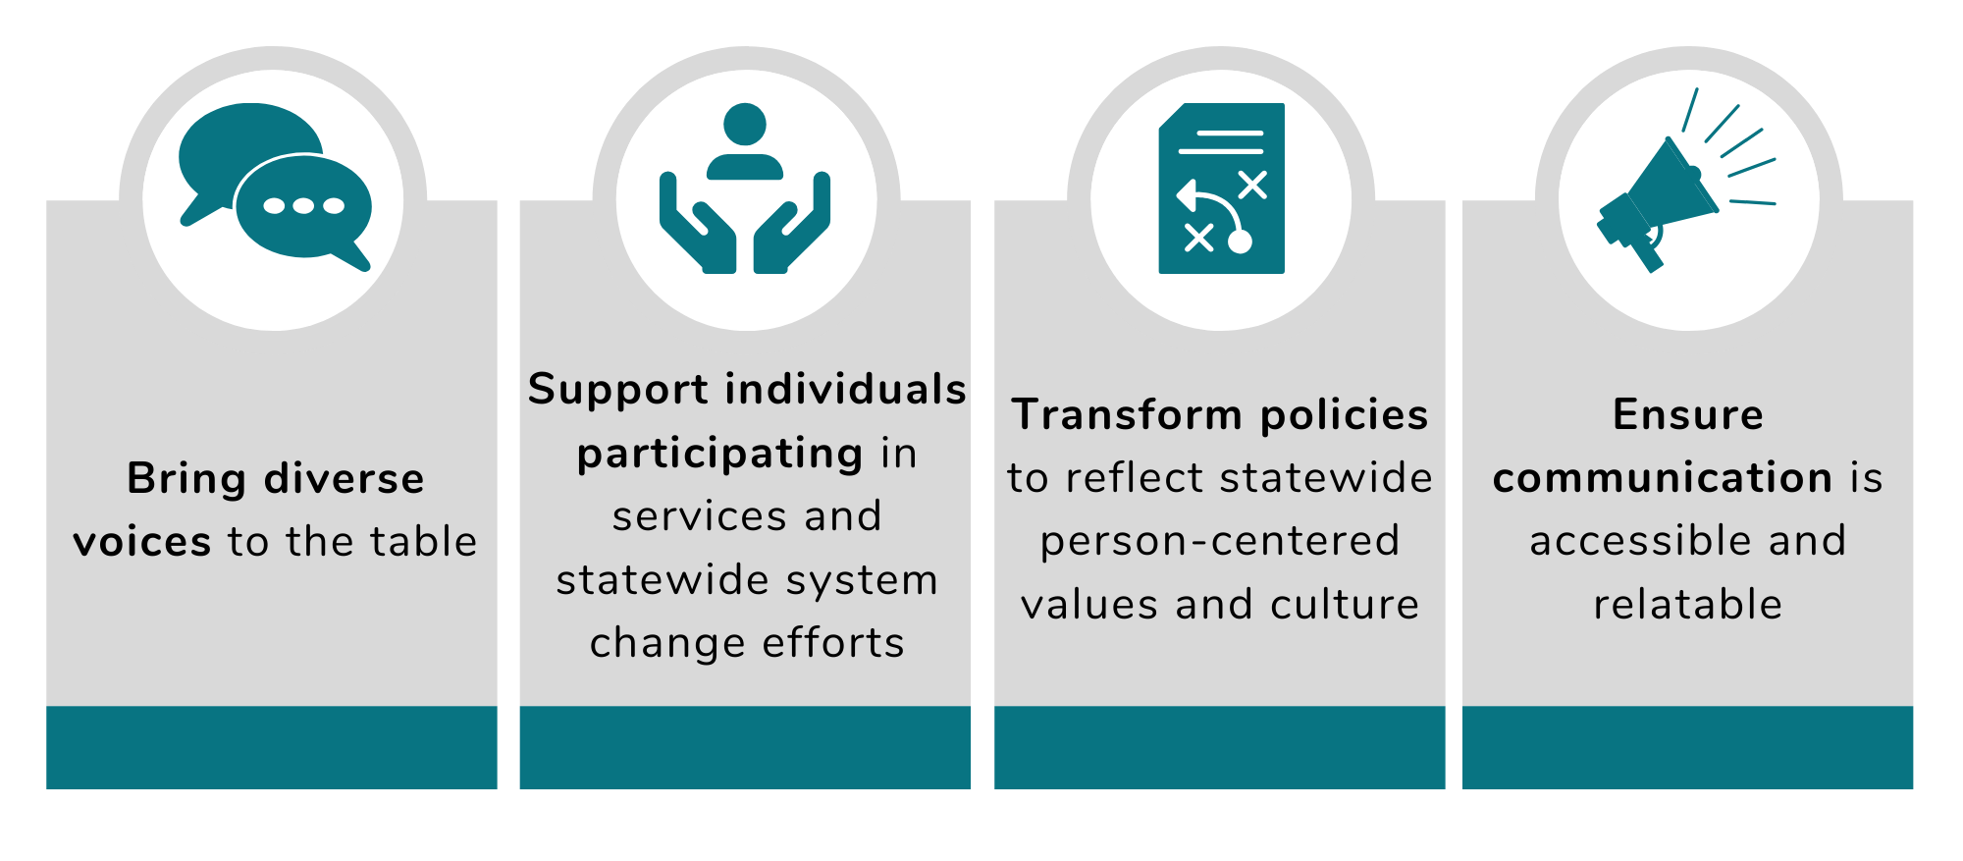
How to Implement

Slide 7
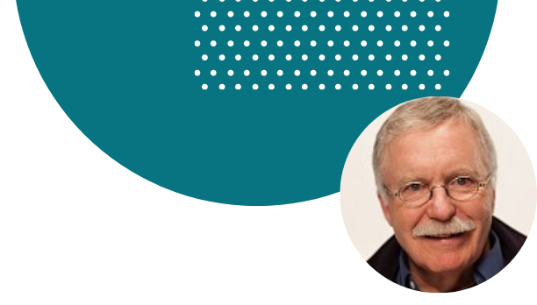

Presentation
Michael Smull
Senior Partner, Support Development Associates
michael@sdaus.com | www.sdaus.com
For the past 48 years, has been working with people who use long term supports and services.
Founder of The Learning Community for Person Centered Practices, www.tlcpcp.com.
Co-developer of person-centered thinking and essential lifestyle planning – providing training and consultation in 49 states and 8 countries to make changes needed to support Person-Centered Practices.
Written extensively on person-centered thinking and planning, the challenge of changing to a person-centered system, and issues relating to supporting people with challenging behaviors.
The person-centered thinking framework developed with colleagues is reflected in the HCBS final rule.
Most recently received 2020 National Honors from the National Historic Recognition Project for significant national contributions in the field of intellectual and developmental disabilities in the United States between 2000 and 2020.

Slide 8
It’s About Supporting Humans

Slide 9
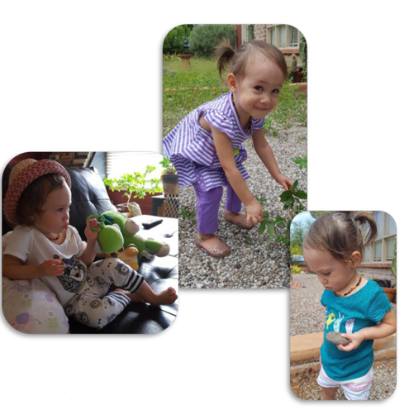


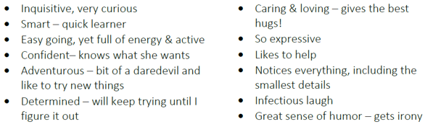

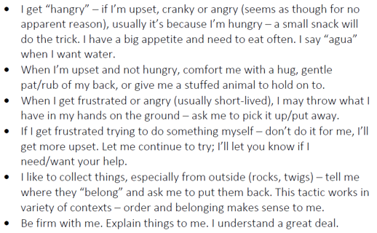


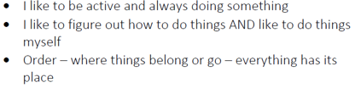
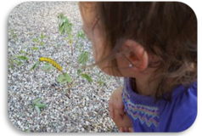
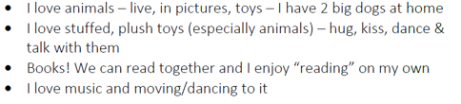
Anya
August 2017

Slide 10
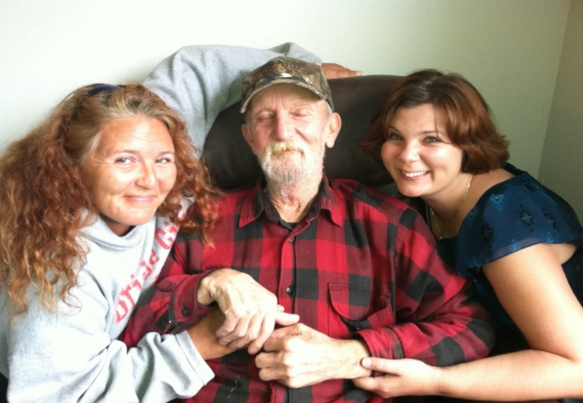
Sam’s One Page Profile
Important to Sam
At least weekly calls from each of his 3 kids
(Tina, Dixie, and Bobby)
Getting to see people he likes every day
Feeding the hummingbirds at the complex
(the water for the food MUST come from Spring Creek)
His friends, Bill and Vince
Staying busy
Sam LOVES
Budweiser (his daughter has figured out how to make beer slushies (recipe on freezer door)…help him have a teaspoon or so every once in a while. He will spit it out if his throat is sore; but he loves the taste.
Supports Sam Needs to be Happy, Healthy and Safe
Assistance with his feeding tube (he will tell you how much to fill it by showing you with his thumb and forefinger).
Someone to assist him with shopping (if he’s too tired to cross the street).
Support with taking the morphine through the feeding tube. He doesn’t want enough so that he is sleepy, but he needs enough to cut the pain. He’ll show you how much he wants.
Someone must assist in filling the hummingbird feeders. He is distressed if they are empty.
Rides to his medical appointments. It helps if you can check with the discharge desk for any special instructions. Sam doesn’t hear well and gets frustrated.
Help him remember to rest throughout the day, which may include limiting visits or length of visits. He falls when he is exhausted but will choose company over safety.
What People Like and Admire about Sam
He always wants to help others before he takes care of himself.
He tells great, funny stories…some are pretty raunchy…get used to it.
He can fix ANYTHING and will always offer to assist.
He is a jokester. Sam loves “Pierre and Boudreaux” jokes and must know 100’s of them.
He loves his family and friends and always has time for them.

Slide 11

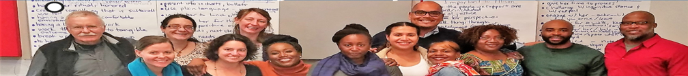
SODA’s One Page Description
What is Important to SODA
Making progress in improving the lives of the people we support
Focus on the outcome of improving people’s lives
Connection to each other’s work
To be organized, respected and acknowledged
Making respectful change
Having integrity in our work and making work meaningful
Be given opportunities to continue to learn
Open and honest communication
Be honest and patient with each other
Look for ways to empower each other
Share our work in research and conferences
Supports SODA Needs and Appreciates
Transparency on everyone’s projects
Clear communication
Praise reports
Celebrate small accomplishments
Share success stories
Motivation bank
Access to training and development
Being aware of SODA updates
Team building exercises and time for them
Community service/team projects
Build in no-working hanging out time
What People Like and Admire about SODA
Our diversity, diversity of talent
That we are outcome oriented, focused on accomplishments
We are accountable
Advocates for social justice
Dedicated, committed, energetic
High performing

Slide 12
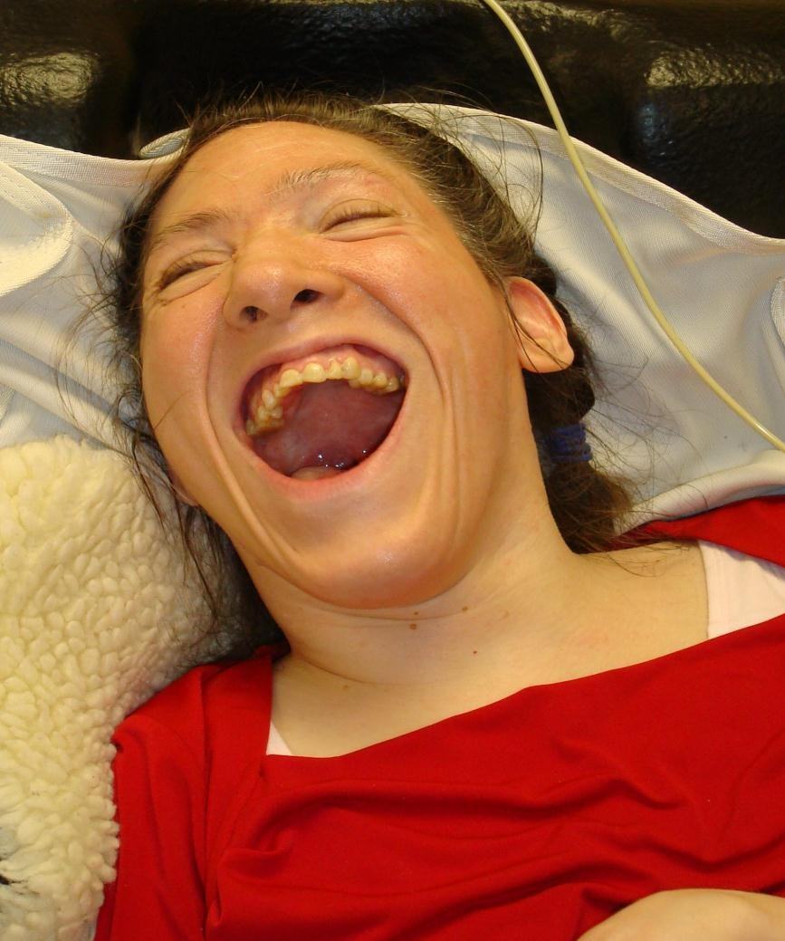
Tammy’s One Page Description
What is Important to Tammy (pages 7-8)
Being a part of things
Having eye contact with everyone
Looking stylish and having her hair and nails done
Being comfortable and not having her tubes underneath her
No roughness in personal care
Supports Tammy Needs to be Happy, Healthy and Safe (pages 10-14)
Always have her head elevated
To be suctioned frequently (5-6 times per shift). Gurgling noises means she needs to be suctioned
To have people be kind, sensitive, loving and have a gentle touch
Be gentle with brushing her hair (she doesn’t like it, but wants it to always look nice)
Always make sure her clothes match and make sure it’s not sweat clothes
Tammy needs to be repositioned every two hours
Always follow through with a promise or give an explanation of what is going on and when you can keep the promise if something comes up
Be sure to have Tammy use her body to keep flexible
What People Like and Admire about Tammy (page 6)
Is always smiling
Totally accepts people
WONDERFUL personality
Stylish
Accepting and forgiving
Resilient
Great sense of humor
Friendly and social
Tammy’s Picture Of A Life (Pages 19-21)
Live in a big wheelchair accessible home with extra wide doors, close to her family
Have a fun and social housemate
Have a beautician she can go to regularly
Have a social medical day program close to home
Have specialized medical services and medical equipment (including backup generator)

Slide 13
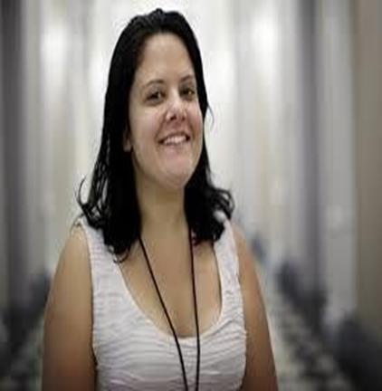
Sara’s One Page Description
What is Important to Sara (pages 6-8)
Being respected and people not breaking their promises
Being social, joking and doing things with friends
Making a difference for people
Being able to smoke without being bugged
People not messing with her things
Supports Sara Needs to be Happy, Healthy and Safe (pages 10-15)
One person to provide clear directions and expectations
Give her choices to keep her from getting bored. Always have a “plan B’ in case things don’t work out
To be supported unconditionally so she can gain trust in you to help when she moves
Must have people be consistent with her and talk with her when she get upset or starts self-diagnosing herself
Have consistent respite for Sara and others to relax and recharge
ASK Sara to do something, rather than tell her.
Always follow through with a promise or give an explanation of what is going on and when you can keep the promise if something comes up
Always check in with others that support Sara to be sure you have the full story and can be consistent with the support she needs
What People Like and Admire about Sara (page 5)
She has a passion and zest for life
Friendly and fun
Positive energy in wanting to advocate for others
Likes to help and is protective of others
Very independent
Knows what she wants to do and is resourceful
Sara’s Picture Of A Life (Page 20)
Live in a Host Home where she can have her own living space and be able to smoke outside
Have an active community that has good public transportation and advocacy opportunities
Have a GED class that can lead to paid work for her
Have mental health services to support Sara and her new provider

Slide 14
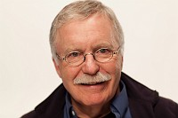
Michael as TLCPCP Board Member
What is Important to Michael
Helping others to grow
To be part of an organization that works on changing the system. Where -
We work in partnership
I am part of the problem solving and testing the solutions
We learn how to do quality at scale
We share the learning and help our efforts spread
To focus on the future, to work on “what is next”
That TLC-PCP grows and prospers, now and after I am no longer directly contributing -
The longevity and integrity of the work
Creation of a true learning community
Best Support
I am a good leader but not a good manager – support my strengths
There are always more things to do then there is time.
Action plans, with clarity about who does what by when, are needed
I appreciate being reminded about what is helpful and necessary.
Remember I am best at working on future concerns, but will help with what is needed now
When you want feedback, ask
I lose the balance between work and life, gentle reminders are helpful
What Other Board members Like or Admire about Michael
His vision
Being a beacon
An original thinker
Gives a clear message
Has a clear and unwavering purpose
Explains complex things with an economy of language

Slide 15
Each of us want lives where are supported by and contribute to our communities
Have our
own dreams and our own journeys
Have opportunities to meet new
people; try new things; change jobs; change who we live with & where we live
Have what/who is important to us in everyday life; people to be with; things to do, places to be
Stay healthy & safe (on our own terms)

Slide 16
Have found purpose and meaning through true opportunities to give and contribute
‘To’ and ‘For’ addressed
Closest people are paid or family
Few real connections
Service Life
OK
Life
Pleasant
Life
Meaningful Life
‘To’ and ‘For’ present
Building on strengths
Active circle of support
Included in community life
‘Important For’ addressed
No organized effort to address ‘Important To’
Notes:
ANIMATED
Content Trainer:
The required minimum standard is “Service Life”: issues of health and safety are adequately addressed. The presence of what is “important to” depends on who supports you, on how much they care about you – it is random and unpredictable.
How many of you have done direct support? (raise hands) How many of you have worked with someone you deeply cared about? You knew what made that person really happy, and you made those things happen. But eventually you moved on and were no longer in that person’s life.
How many of you have worked with someone who rubbed your fur the wrong way? You weren’t happy and they weren’t happy. You did what it took to keep that person healthy and safe.
But truly achieving the balance of happy and safe requires a relationship.
An OK Life is not a bad place to be. Most (maybe 80%) of what is important to you is present, you are healthy and safe. But if we look at who is close to you; they are either family, other people who use services, or people who are paid. You go to places in the community where you are welcomed, you have some community presence. But real community connections are lacking. What you have is fragile in that you are dependent on the ongoing commitment of the organization that supports you. Have you seen the “mother duck tour” of Wal Mart? The van pulls up and a group follows the staff up and down the aisles. People don’t approach groups of people. You’ve probably seen the groups of people who show up at the McDonalds and sit in the corner while the
A Pleasant Life has been our goal for the past 20 years.
A Pleasant Life is defined by relationships. When you are here you may still have people who are paid in key roles, but those who watch out for you and plan with you are mostly unpaid. You are not just present but participating. Because many people have achieved an OK Life we have learned that an OK Life does not fully satisfy people. People who have achieved an OK Life have sought, through words and behavior, opportunities to have purpose and meaning through opportunities to give and contribute.
A Meaningful Life is where people have discovered and acted on those things that give their life purpose and meaning (it could be helping others, bringing a smile to someone’s face, etc. ) People contribute and give back to their communities and the relationships aren’t just one sided, they are reciprocal.

Slide 17




Person-Centered Plans Should Describe
How to Move Toward Your Desired Life
Who You Are
How You Want
to Live

Slide 18

Person-Centered Planning
Is never done to you
Is always done with you
  Supports you in having positive control over the process
Helps you move in a positive direction

Slide 19

What It’s About
Person-Centered Planning is about:
  Asking the right questions
  Respectfully listening
  Organizing the learning

Slide 20
The First Questions
What do you want the plan to help accomplish?
Who is going to use the plan and how?
Are there issues of culture or identity we need to be aware of and plan for them to be addressed respectfully?
What do we need to learn, what needs to be written down?
Are there sensitive issues that need to be addressed outside the meeting?

Slide 21
Then Ask…
1 | What planning process best matches the answers to the first questions?
2 | Who, besides you, should we listen to? Who has helpful information? What questions would be helpful to ask?
3 | What role(s) do you want to have in the process? Do you want to lead the meeting/ask the questions? Do you want to write the plan (with support)? Do you want to actively edit or just have final approval? Something else?

Slide 22
After learning what someone wants to accomplish and desired outcomes, ask:
How can we help you get from where you are to where you want to be?
How do you want to be supported while on the journey?
How can you make the best uses of the resources available to you?
What is going well that you want to maintain and what do you want to change?

Slide 23
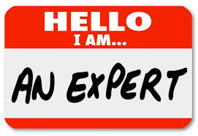
Process Experts + Content Experts
Process Experts
Content Experts
The primary content expert is always the person whose plan is being developed
Good Process Experts
Help the person have positive control over the process
Help and encourage the person to become their own process expert
Know how to develop and write a Person-Centered Plan
Know what the plan should say

Slide 24
Good Plans Are Living Plans
Your vision of the life you want and how to get there changes with experience
First efforts at planning reflect what is known at the time of planning
Efforts at implementing generate learning about what works and doesn’t work
Plans should evolve with the learning

Slide 25

When You Read a Good Plan
You feel that you have met the person (and not just the disability)
The plan respectfully reflects the person’s culture and identity
You know what the person wants the plan to help accomplish
How to best support the person in moving toward their outcome(s)
is clear

Slide 26

It’s More Than Planning
Person-Centered Planning, by itself:
Results in Better Paper more often than it results in Better Lives.

Slide 27

What Would a Person-Centered System Look Like?
How would we know?

Slide 28

Person-Centered System:
8 Parts Must Work Together
1
Vision, mission and values that are routinely used
2
Effective ways to learn the outcomes that each person wants
3
Engaged staff who use the skills needed for implementation
4
Planning, practices, and supports that are Trauma Informed

Slide 29
Person-Centered System:
8 Parts Must Work Together
5
Alignment of external and internal pressures to support the first four parts
External and internal advocacy for the vision and alignment, including what does and does not get public funding
6
7
A quality measurement system that measures effectiveness and identifies areas for improvement
Leaders that understand all the above and engage in sustained and consistent actions for their implementation
8

Slide 30
Leaders Support a Positive Organizational Culture
Build/Maintain Positive:
Learning
Accountability
Partnership
Open to learning, seek to understand
Question assumptions
Seek opportunities for improvement
Act on learning
Clarity about performance expectations (donut)
Shared perceptions about performance
Shared action where expectations are not met
Respect
Trust

Slide 31
Leaders Support a Positive Organizational Culture
Reduce/Eliminate Negative:
Blame/Fear
Crisis
Silent
Avoid responsibility
“Band-Aids” rather than real solutions
Don’t question authority/hierarchy
Too little time because of number of crisis
Real input not solicited/welcomed

Slide 32
Fixing vs. Supporting
Power Over
Power With

Slide 33
Questions + Answers

Slide 34
Break: Five Minutes
1
Take a five-minute break.
2
During that time, please visit: www.menti.com and use the code: 72 71 99 6
3
Use a few words to describe what Person-Centered Practices mean to you.
4
After break, we’ll review the results together.
5
After the webinar, we’ll use the results to create a North Dakota definition for Person-Centered Practices.

Slide 35
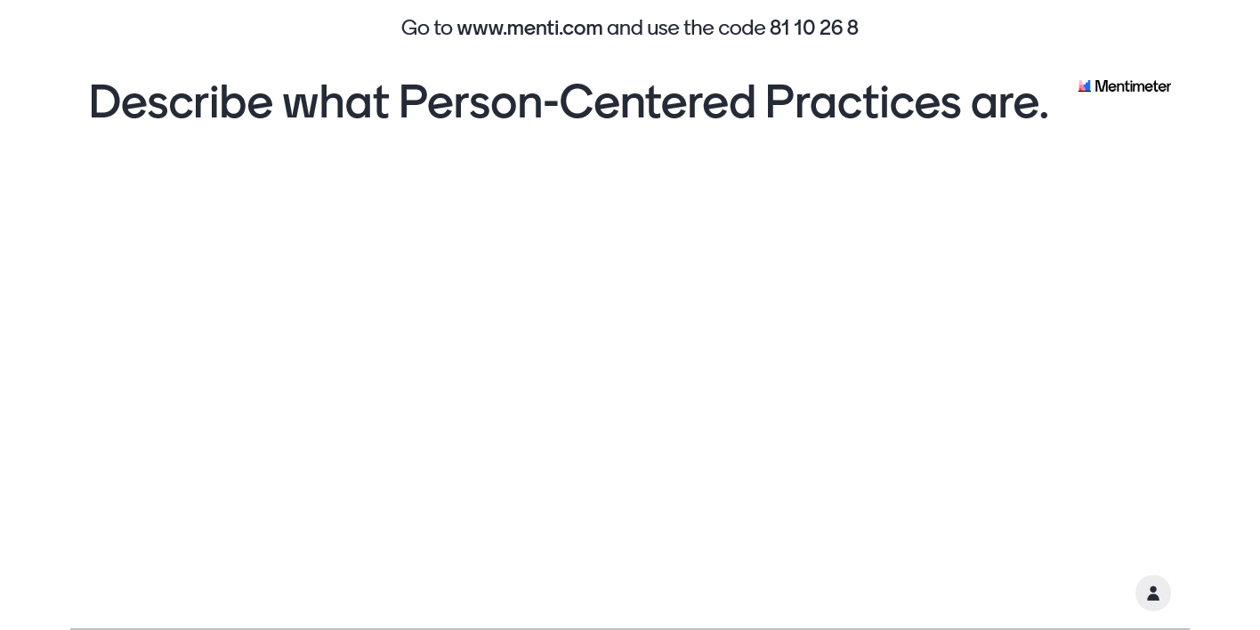

Slide 36



Panelists Sharing Lived Experiences
Tanya RedRoad
Parent Coordinator,
ND Federation of Families for Children’s Mental Health
Jake Anderson
President of Advocates Leading their Lives (ALL) Group
Sheryl Beard
ALL Group Member

Slide 37
Closing + Next Steps
1
Register for our next webinar (and invite colleagues and friends!) at: https://zoom.us/webinar/register/WN_j7P4-qu5RYCdCuBmTqOrcA
2
Responses to the word cloud exercise will be used to develop a North Dakota definition of Person-Centered Practices.
3
Begin or continue having conversations about PCP, including what it means to you and how systems can be enhanced to provide better experiences.
4
Visit www.hsri.org/nd-pcp to view and use the materials currently available. The recording and slides from today’s webinar will be available within two weeks.
5
Complete the polling questions to help inform future webinars.

Slide 38
Thank You

